Slide 1
Weakly Supervised Nuclei Segmentation via Instance Learning
Weizhen Liu
Xuan Gao
Qiyuan Ma
Notes:
Hi, I’m Weizhen and I’ll introduce our work: Weakly Supervised Nuclei Segmentation via Instance Learning.

Slide 2
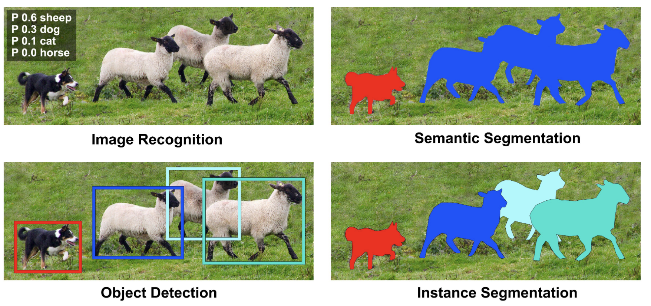
Instance Segmentation
Instance segmentation
Characteristic of semantic segmentation: pixel-level classification
Characteristic of object detection: locating difference instances, even if they are of the same class

Slide 3
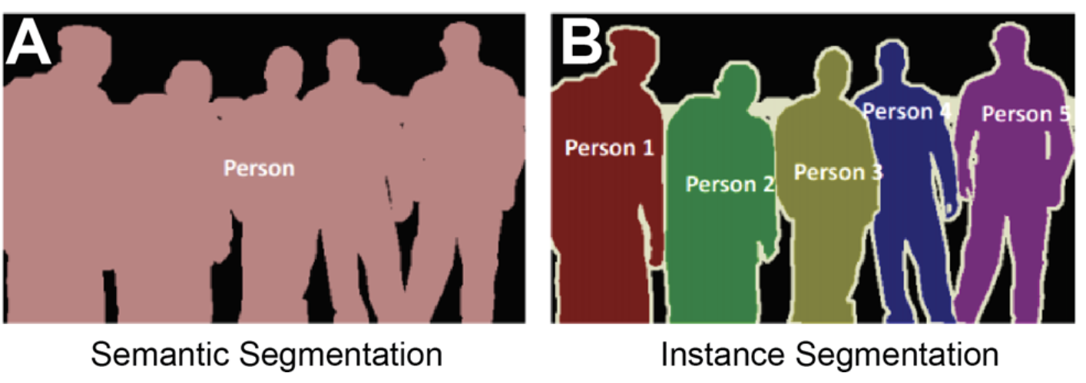
Instance Segmentation
Top-down detection-based
Bottom up:
Perform semantic segmentation at the pixel level
Distinguish different instances through clustering and other methods.
Notes:
Firstly, perform semantic segmentation at the pixel level, and then distinguish different instances through clustering, metric learning, and other methods.

Slide 4
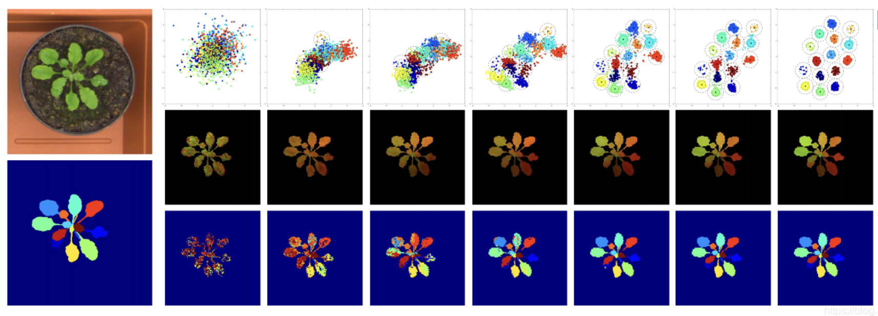
(1) Semantic Segmentation
(2) Pixel Embedding: a discriminative loss function is used to train the network, where the optimization goal is to project each pixel of the image into an n-dimensional feature space
(3) Post-processing: Distinguish different instances through clustering and other methods. mean-shift

Slide 5
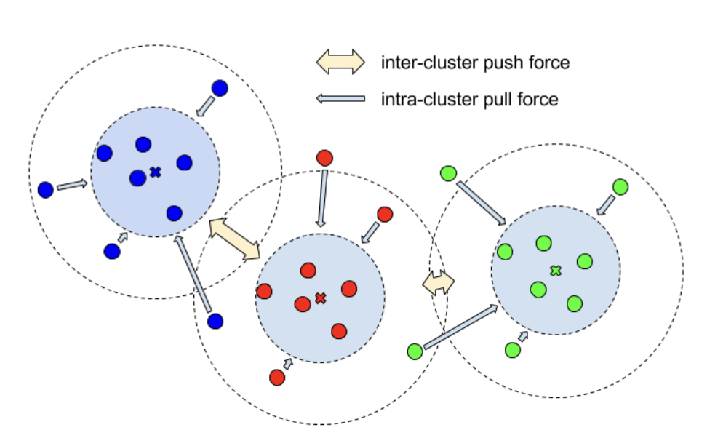
Loss Function
(1) variance term: an intra-cluster pull-force that draws embeddings towards the mean embedding, i.e. the cluster center.
(2) distance term: an inter-cluster push-force that pushes clusters away from each other, increasing the distance between the cluster centers.
(3) regularization term: a small pull-force that draws all clusters towards the origin, to keep the activations bounded. The center points should not be too far away from the origin.
Bert De Brabandere, Davy Neven, and Luc Van Gool, “Semantic instance segmentation with a discriminative loss function,” arXiv preprint arXiv:1708.02551, 2017.

Slide 6
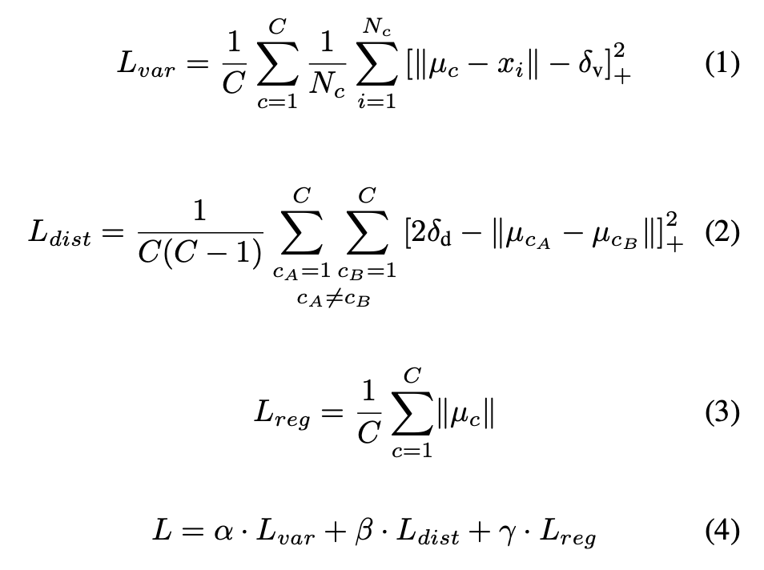
Discriminative Loss
Bert De Brabandere, Davy Neven, and Luc Van Gool, “Semantic instance segmentation with a discriminative loss function,” arXiv preprint arXiv:1708.02551, 2017.

Slide 7
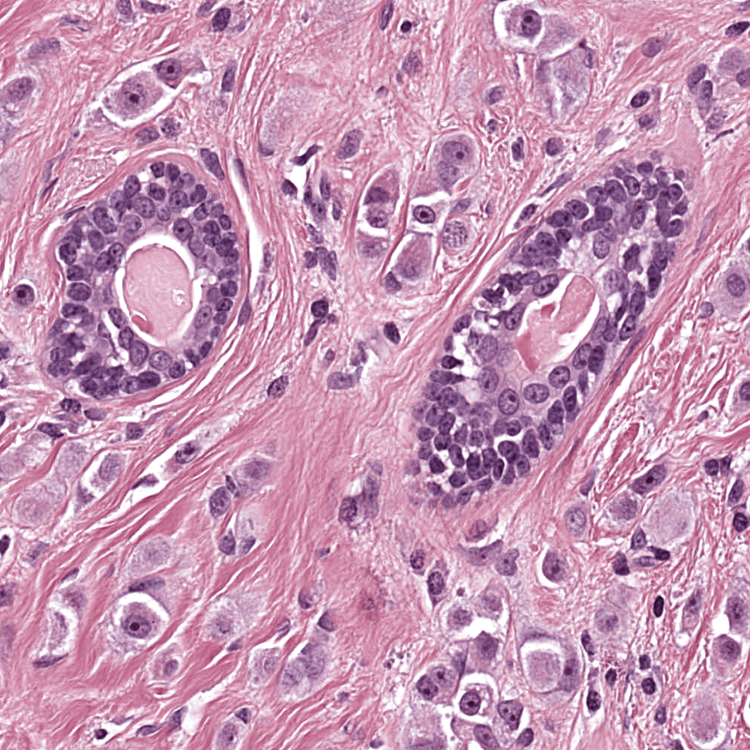

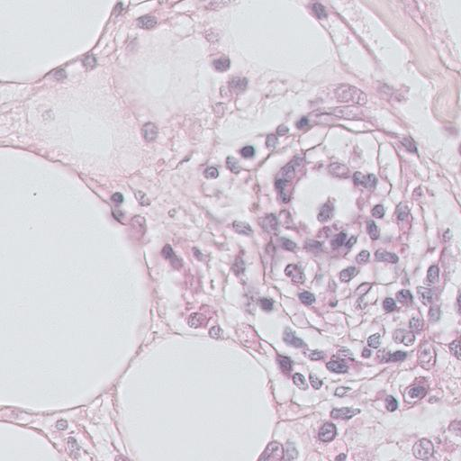

Dataset
Image
Mask
MultiOrgan
30 images of size 1000 × 1000
16 training, 14 testing
Multiple organs: breast, liver, kidney…
https://github.com/weizhenFrank/WeakNucleiSeg/blob/main/data/MO/train_val_test.json
TNBC
50 images of size 512 × 512
37 training, 13 testing
Breast
https://github.com/weizhenFrank/WeakNucleiSeg/blob/main/data/TNBC/train_val_test.json
Image
Mask
Notes:
We conduct experimental analysis on two public benchmarks.
MultiOrgan is a dataset consisting of 30 images for multiple organs, including breast, liver, kidney, etc
TNBC is a dataset consisting of 50 images for breast only.

Slide 8
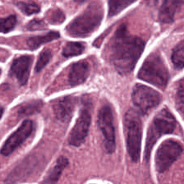


Problem Definition
Nuclei Segmentation
Weak Label – point
Input Image
Output Mask
Segment
Point Label
Notes:
Given an input image, our goal is to segment all the nuclei in this image.
Existing methods have achieved excellent performance on this task with full mask supervision.
However, such full mask annotations are still very expensive and time-consuming to collect.
Therefore, we tackle this problem under the setting of weak label.
Specifically, we choose point label, where each nucleus is labeled with a point to denote its center.

Slide 9
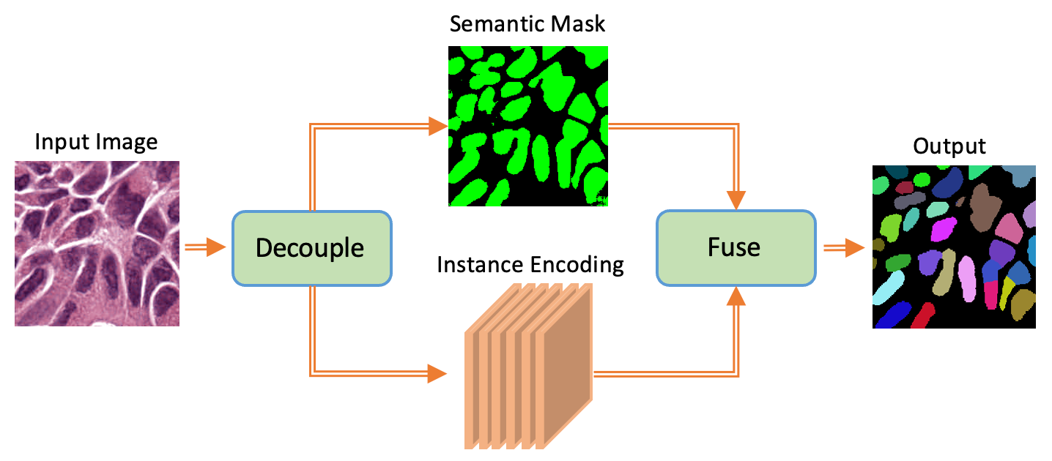
Main Idea
Decouple and then fuse semantic and instance segmentation​
Notes:
To address those limitations, we propose an instance-aware learning strategy.
Our main idea consists of two aspects:
Firstly, we decouple the semantic and instance segmentation process,
enabling the model to effectively learn each of two subtasks as well as their fusion.
Moreover, we introduce a discriminative loss to promote learning an instance-aware representation for nuclei pixels.

Slide 10
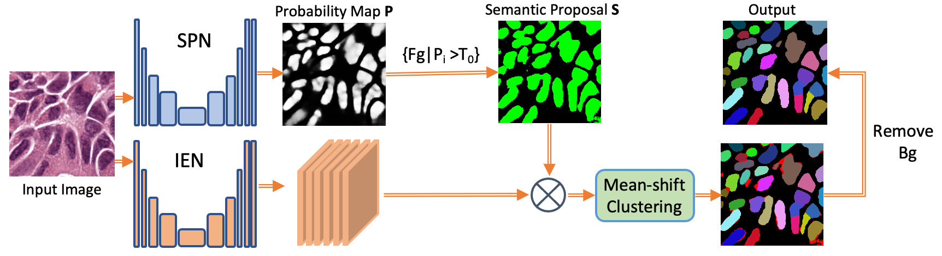
Model Design
Our model consists of two branches:
SPN – Semantic Proposal Network
IEN – Instance Encoding Network
Given an input image:
SPN – generates semantic proposal
IEN – generates instance encoding
Notes:
Our model consists of two branches:
a Semantic Proposal Network (SPN) and an Instance Encoding Network (IEN) .

Slide 11
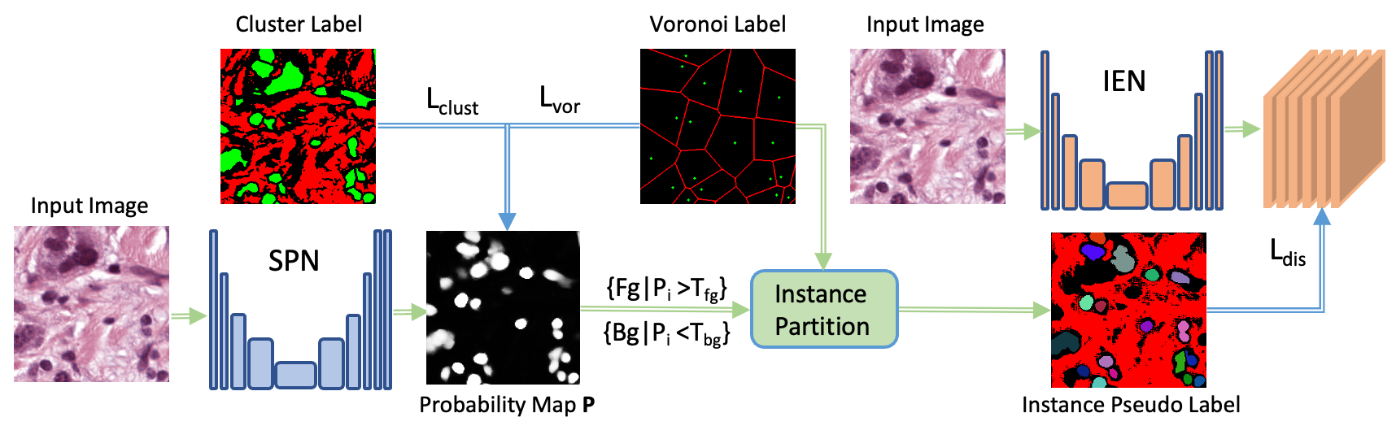
Model Training
Train SPN with cluster label and voronoi label​
Lclust and Lvor are cross-entropy losses on partially labeled pixels​
Train IEN with instance pseudo label
L_{dis} is a discriminative loss for instance-aware representation learning
Notes:
Then we train IEN with instance pseudo label.
L_dis is a discriminative loss for instance-aware representation learning.

Slide 12
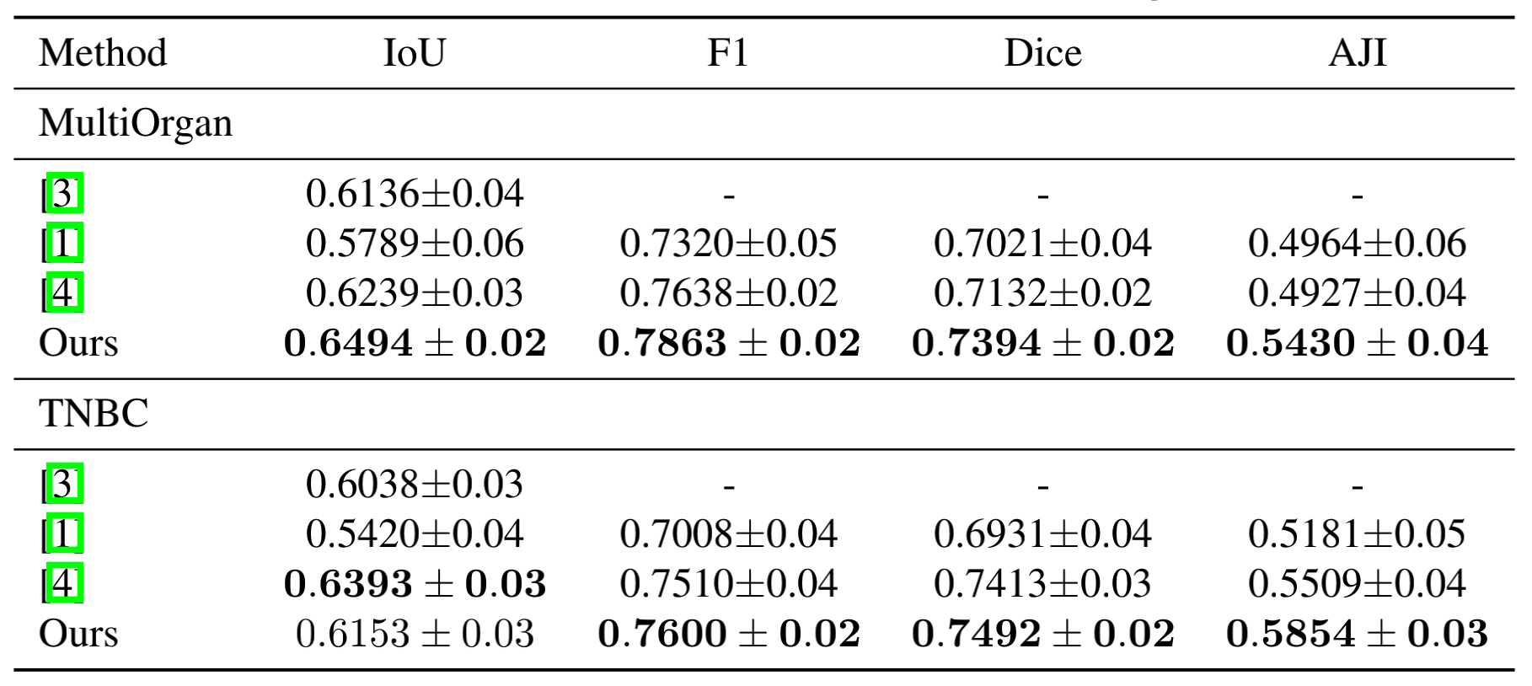
Results
Ten-fold cross-validation on MultiOrgan and TNBC
+5.03% in AJI
+3.45% in AJI
Notes:
Following the previous work, we show ten-fold cross-validation results on both MultiOrgan and TNBC.
We can see that our method achieves state-of-the-art performance on both benchmarks.
Specifically, the improvement in AJI is significant, which demonstrates the efficacy of our model in instance learning.

Slide 13
Visualization
Notes:
One visualization example is shown in the first row for MultiOrgan dataset,
our model is able to split connected nuclei into separate instances.

Slide 14
Visualization
Notes:
Moreover, our method also produces better semantic foreground predictions.

Slide 15
Partial Point annotation?
Question:
Can we extend our method to partial points annotation?
Why partial points annotation?
Even annotate each nuclei with a point is not easy, hundreds of points.
We can’t always fully annotate all the nuclei with points, human error

Slide 16
Analysis on partial points
Pseudo label quality
Label from K-means clustering
Semantic learning results
IOU, F1 metrics

Slide 17
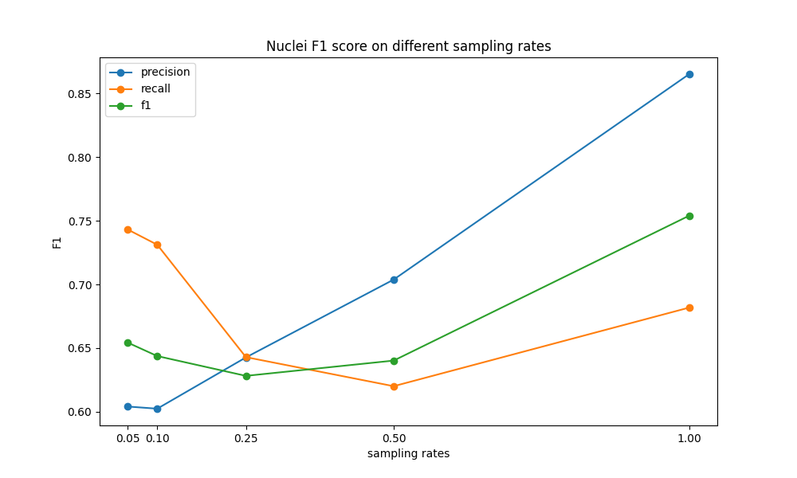
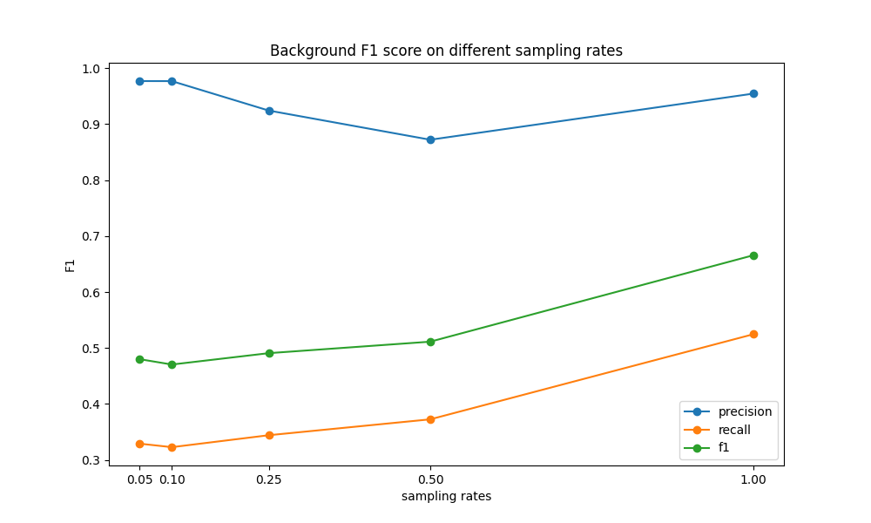
Pseudo label quality
Pseudo label quality
Label from K-means clustering

Slide 18
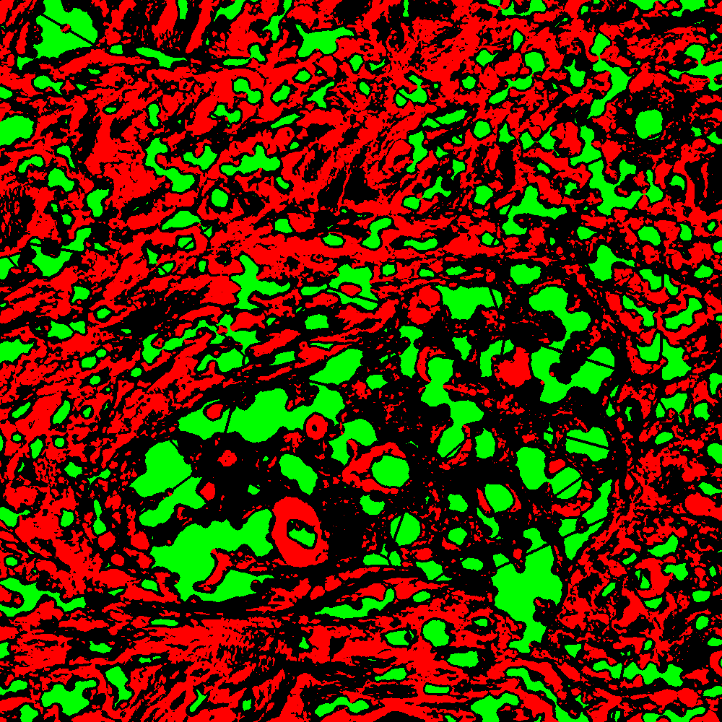
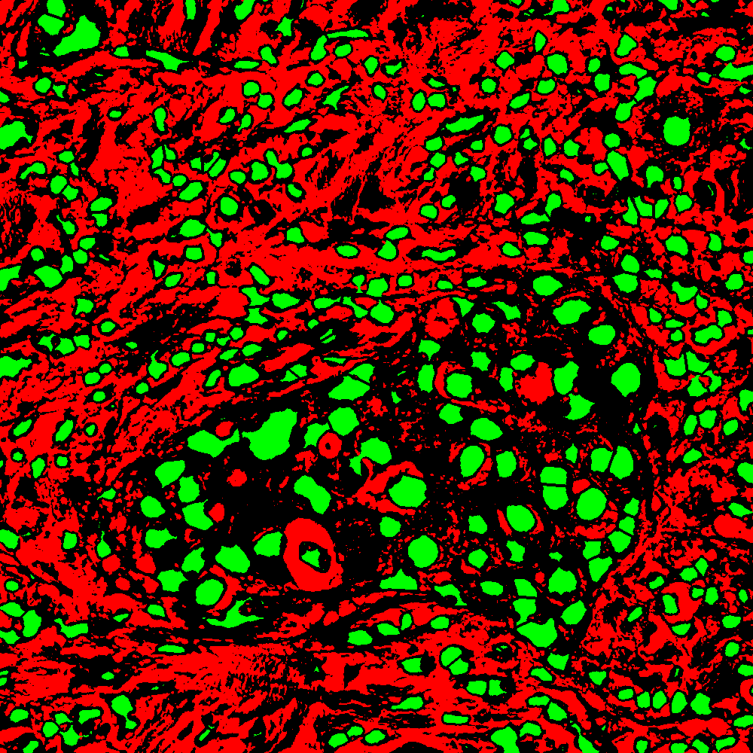
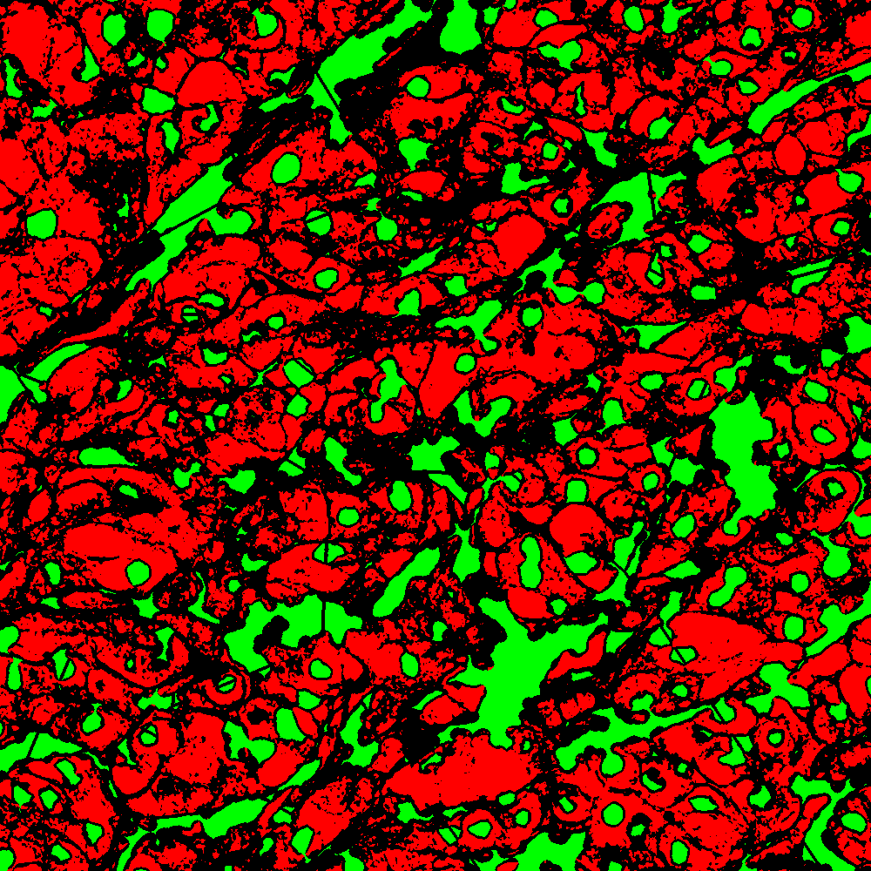
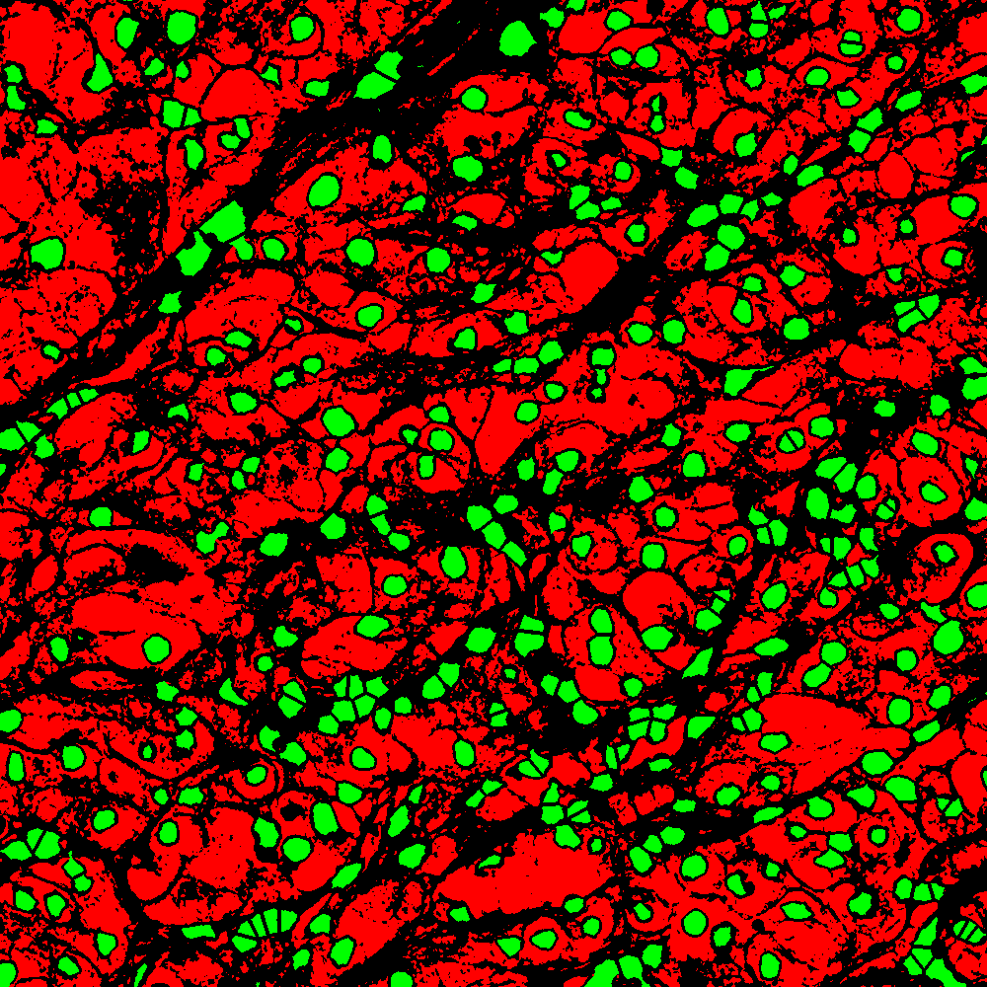
Pseudo label quality
Pseudo label quality
Label from K-means clustering
Sampling rate = 0.05
Sampling rate = 1
Sampling rate = 0.05
Sampling rate = 1

Slide 19
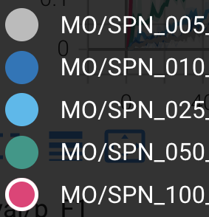
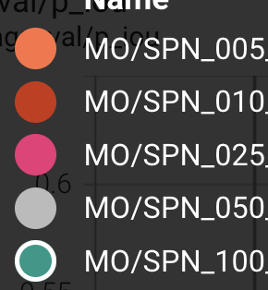
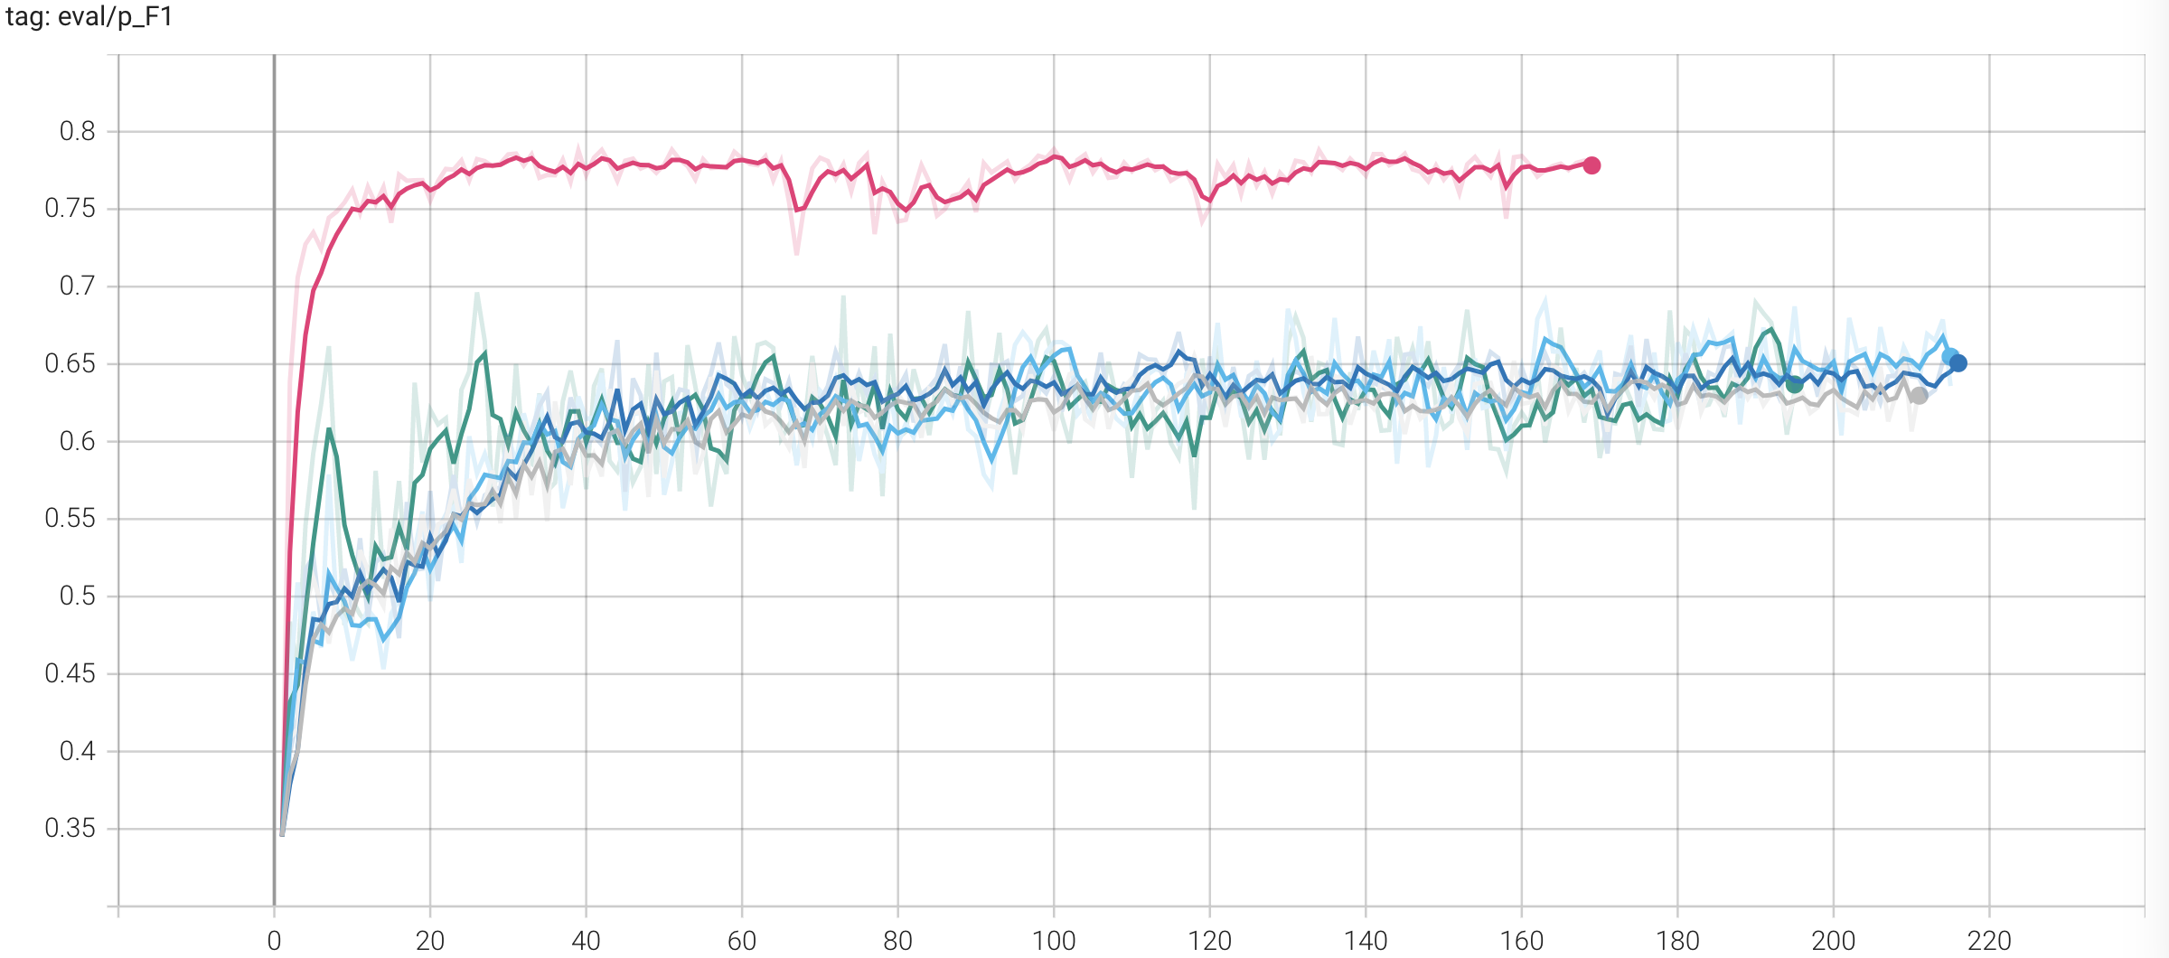
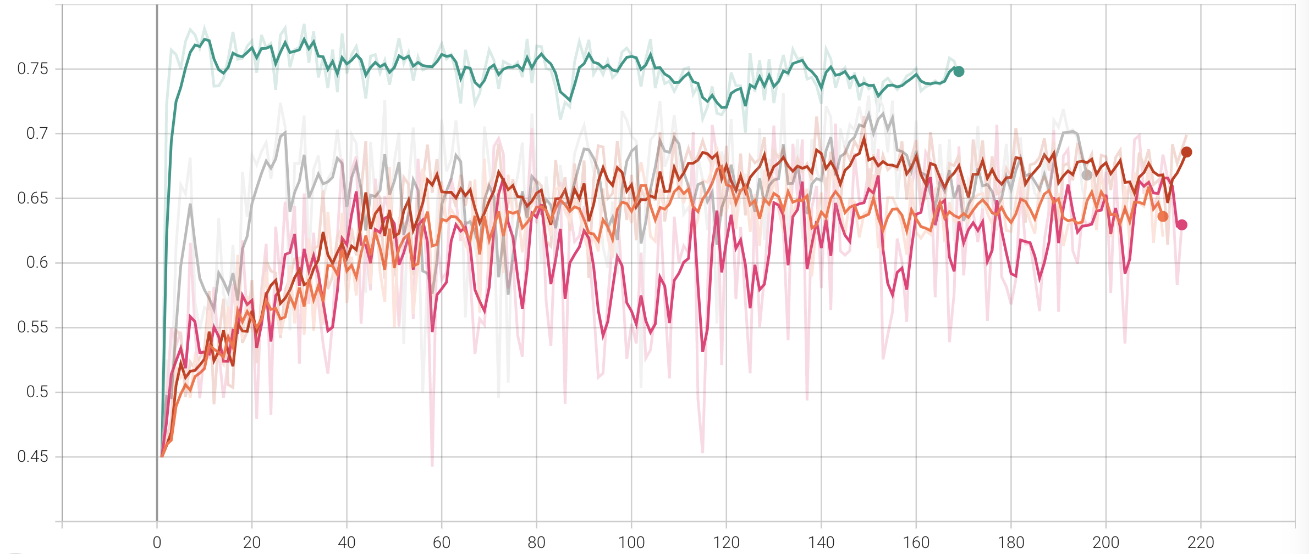
Pseudo label quality
Semantic learning results
F1 metric on training set
F1 metric on validation set

Slide 20
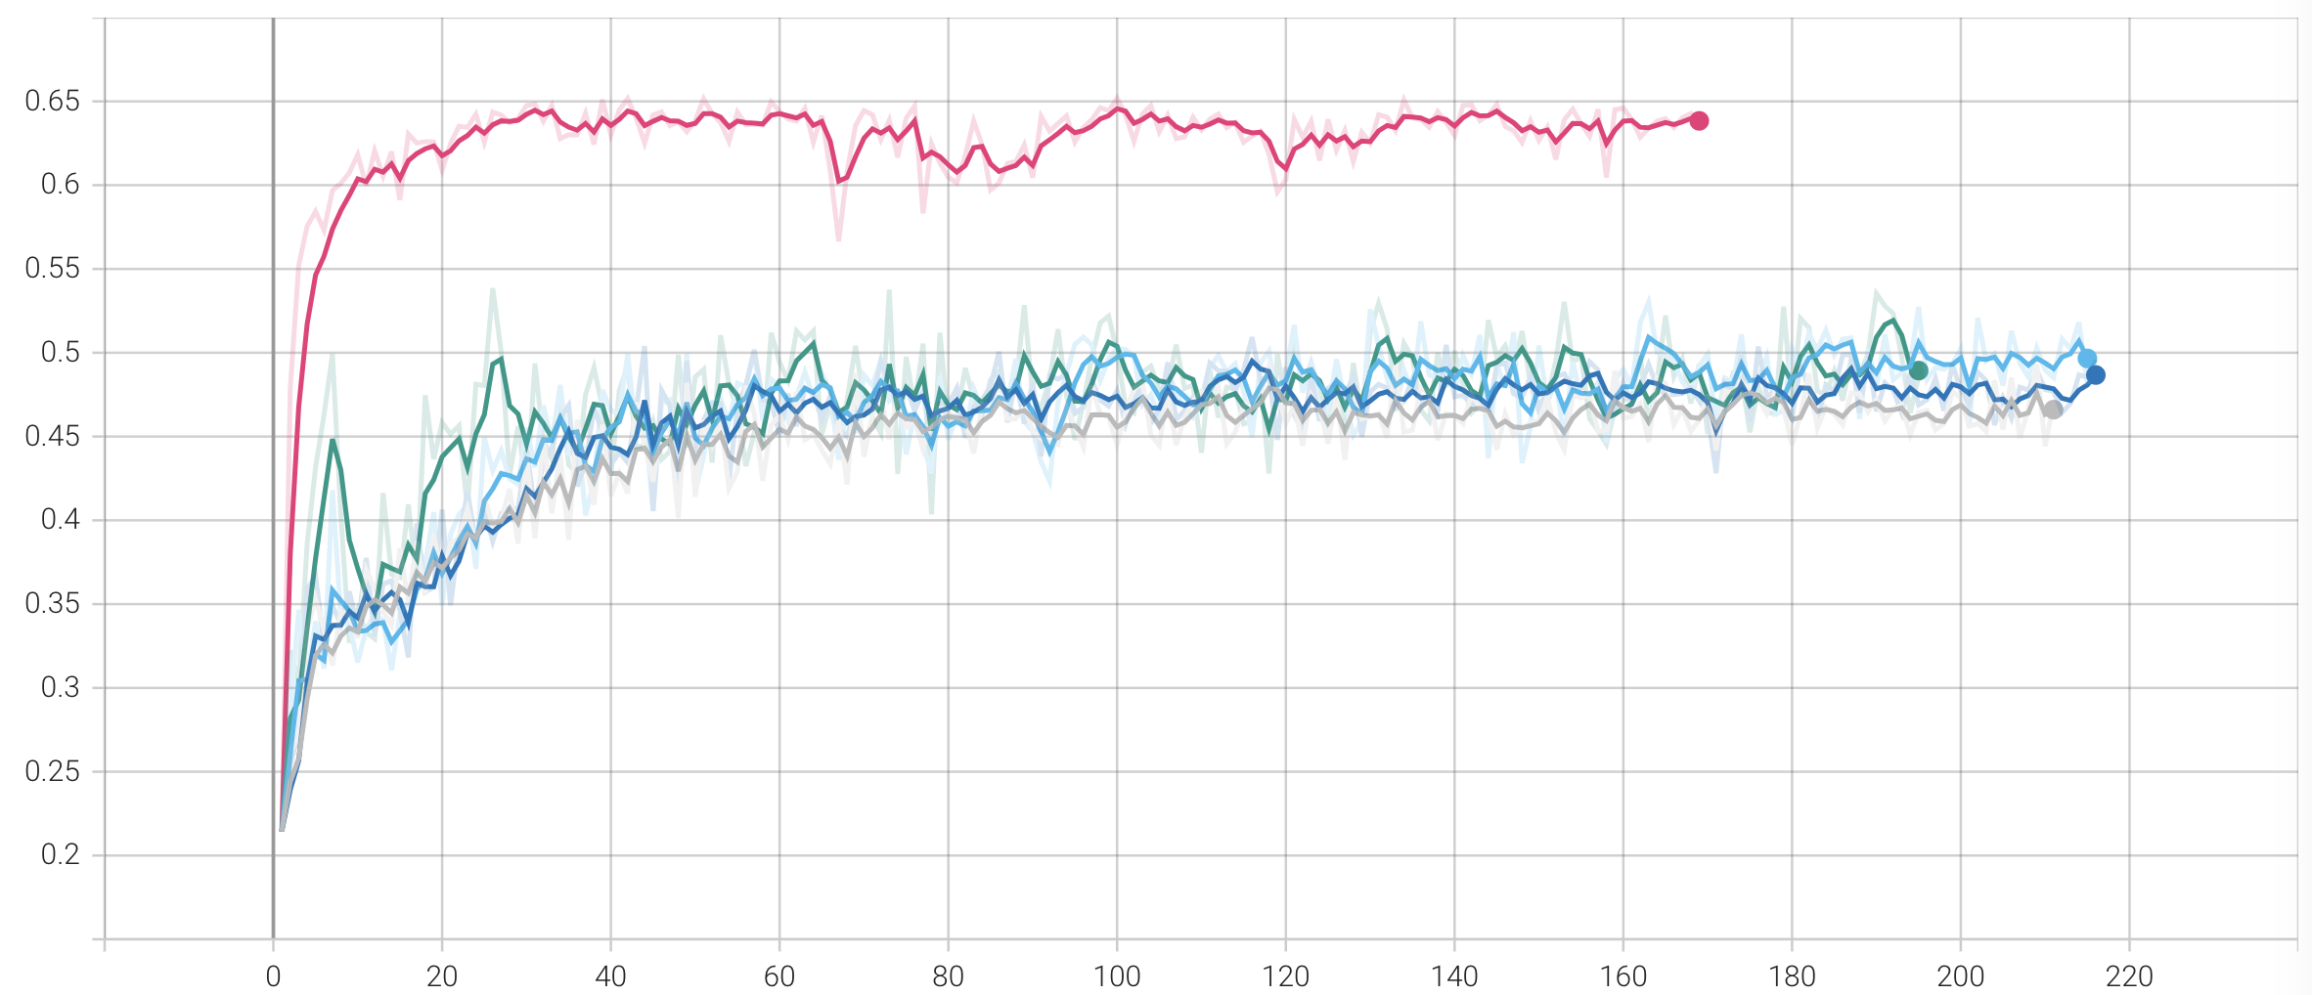
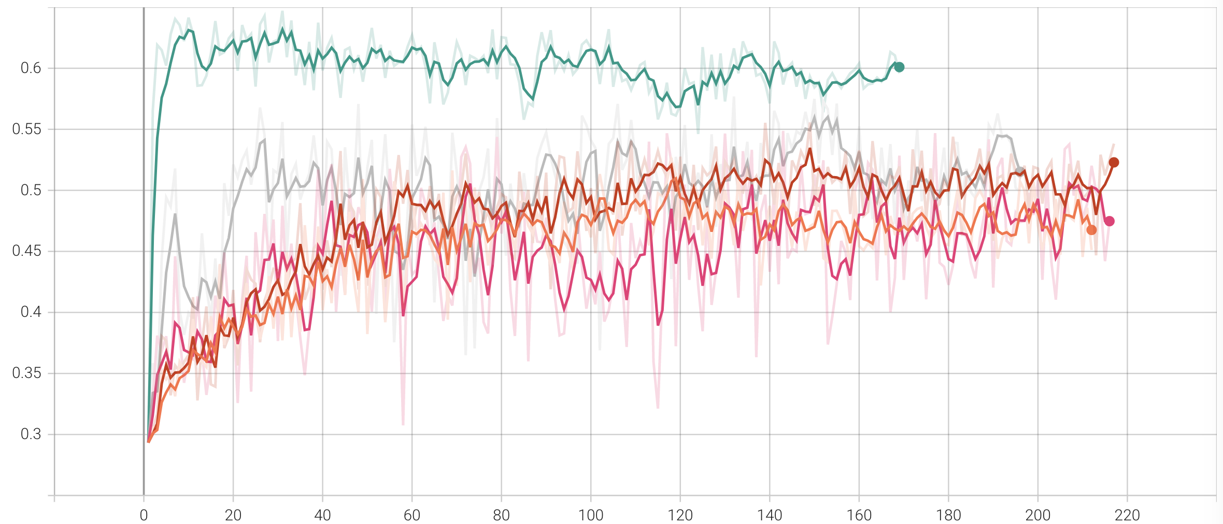
Pseudo label quality
Semantic learning results
IOU metric on training set
IOU metric on validation set

Slide 21
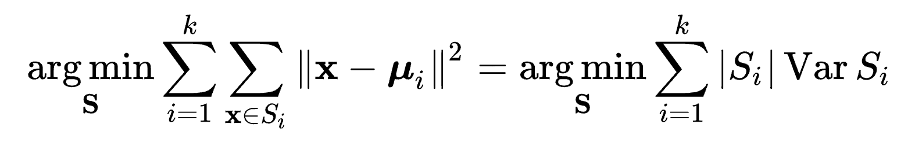

Where’s the problem from
Low quality of K means clustering label

Slide 22
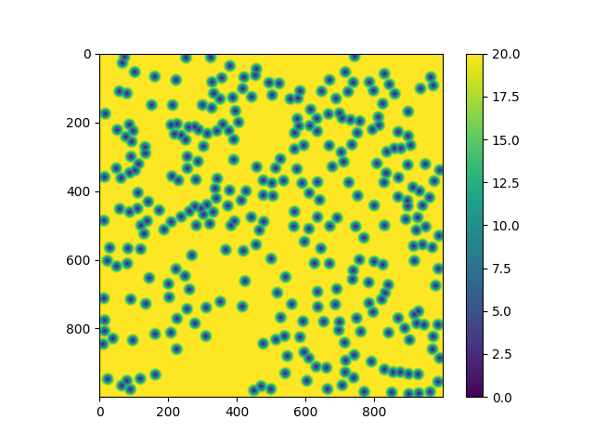
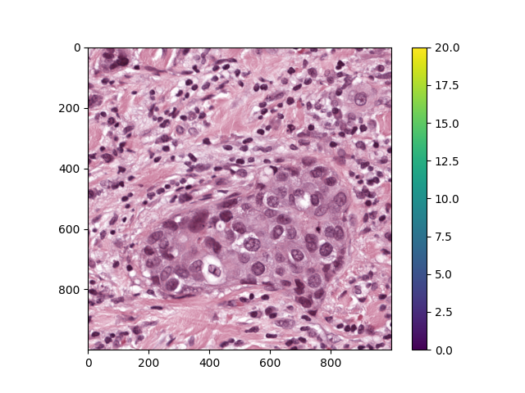
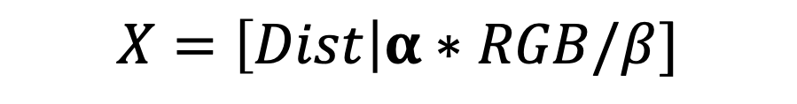
Where’s the problem from
$$X=\left[Dist\right|α∗RGB/β]$$
Our x feature vector comes
Distance map to the point
RGB color image

Slide 23

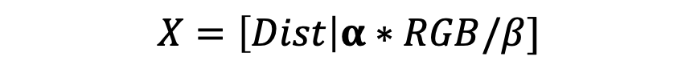
We need to tune $α$ and $β$!
Grid search for best alpha, and beta for different nuclei sampling rate
$$X=\left[Dist\right|α∗RGB/β]$$
Alpha: The balance coefficient
[0.05, 0.1, 0.15, 0.2, 0.3, 0.4, 0.6, 0.8, 1, 2, 5, 10]
Beta: Kernel size to calculate the the image statistics
[10, 20, 40, 60, 80, 100, 120]

Slide 24
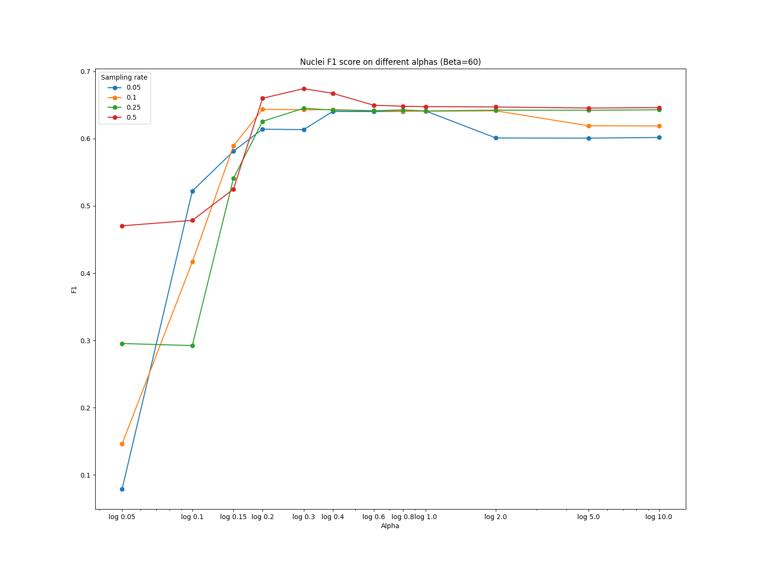
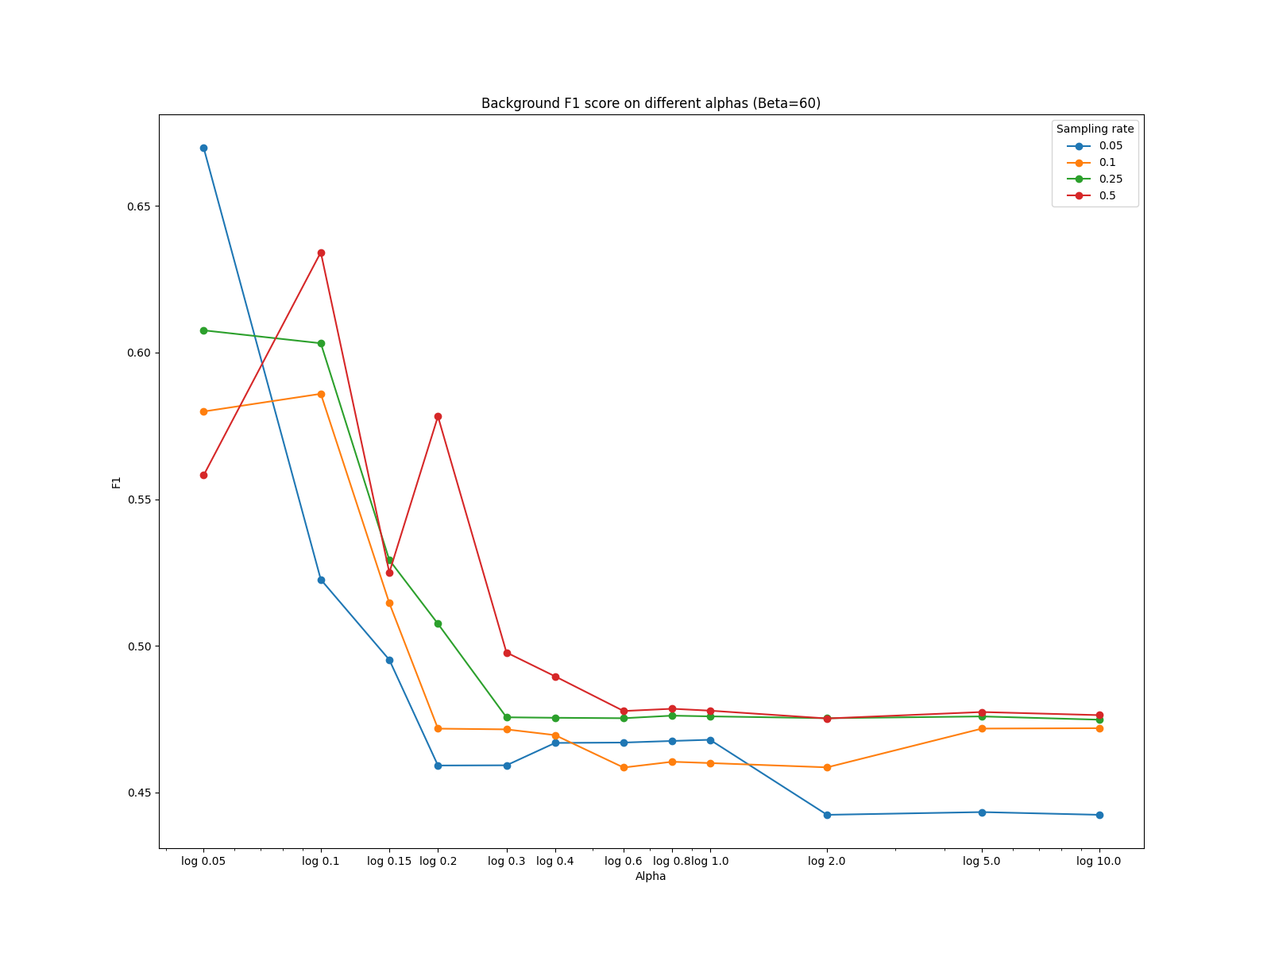
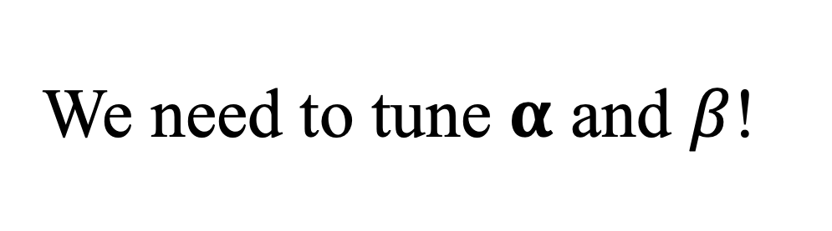
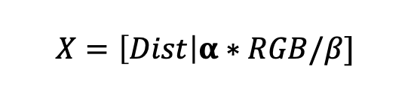
We need to tune $α$ and $β$!
$$X=\left[Dist\right|α∗RGB/β]$$

Slide 25
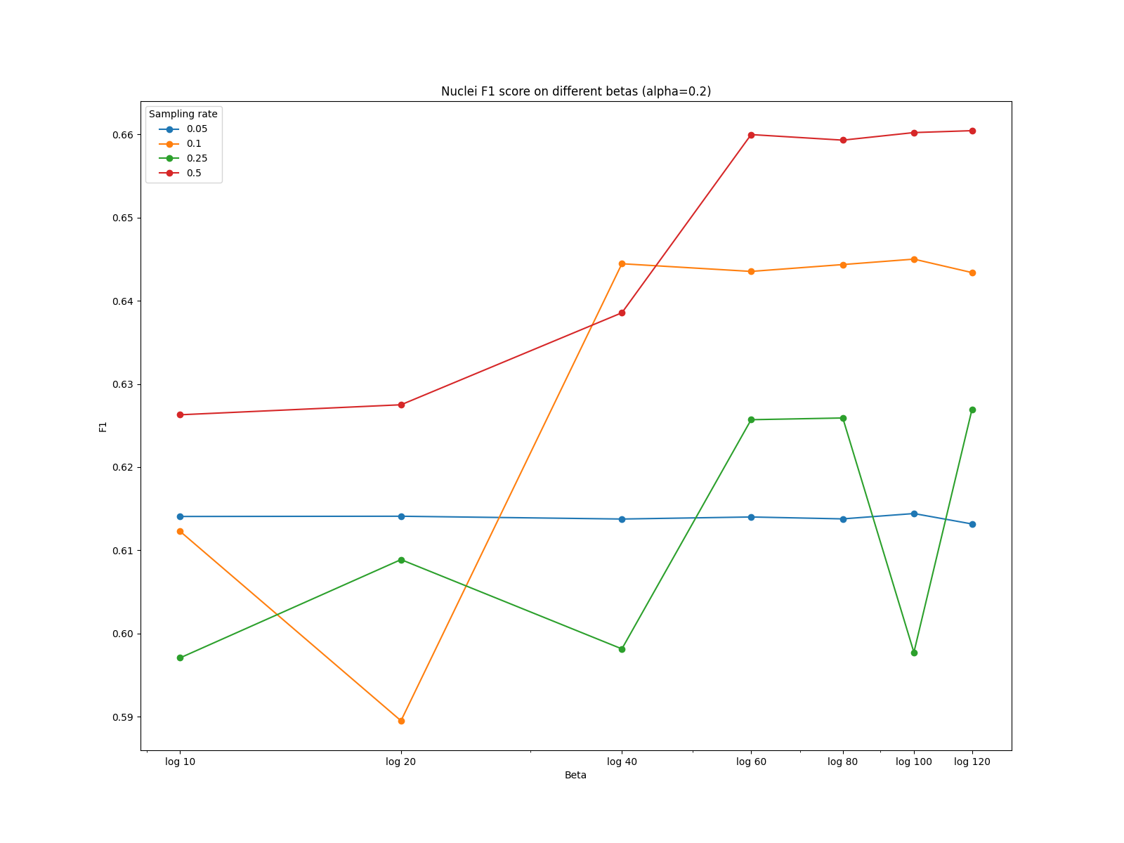
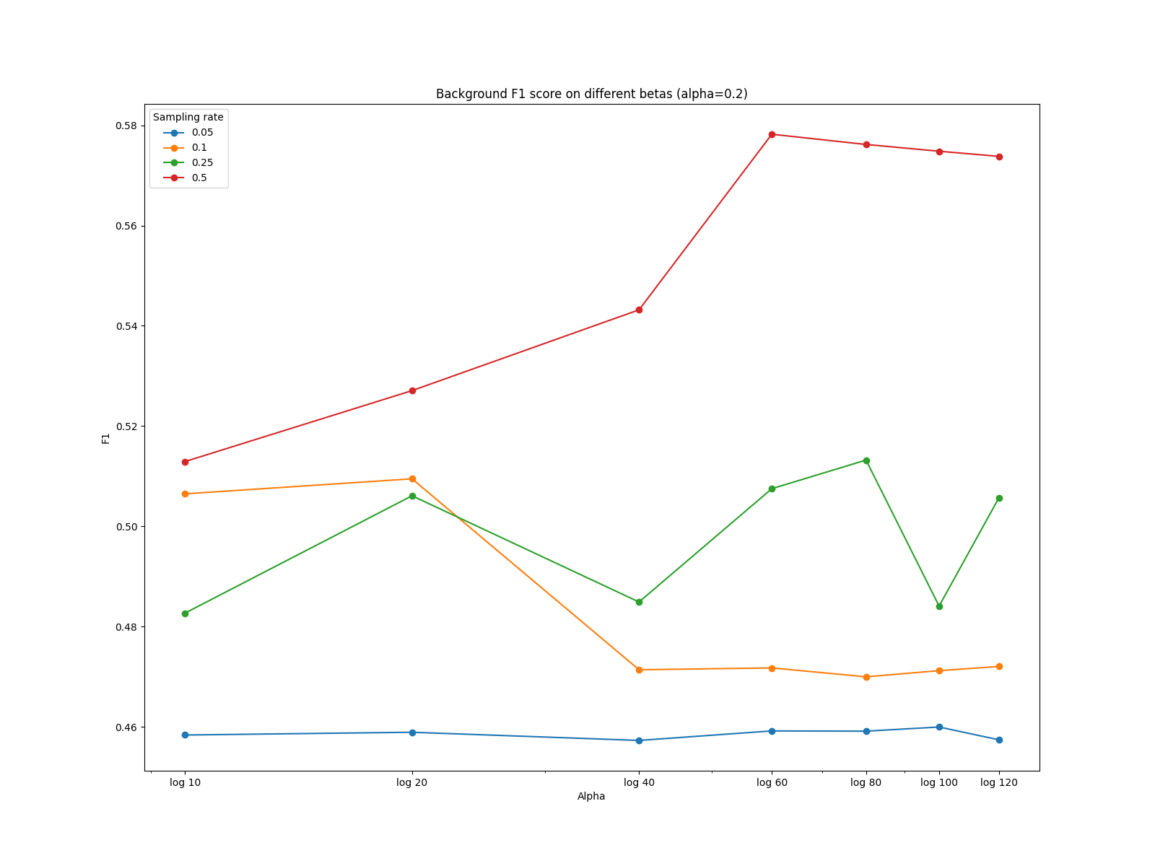
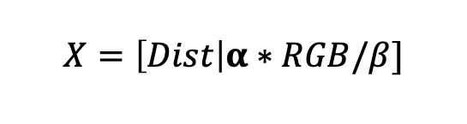
We need to tune $α$ and $β$!
$$X=\left[Dist\right|α∗RGB/β]$$

Slide 26
Conclusion
Our method achieve the best results on full points annotation
Significant improvement in instance metrics on two benchmarks
Extension to partial points annotation
Good news: the balance method quite stable for different sampling
Bad news: even under best tuned hyper-parameter, the pseudo label quality still bad
Raw ideas: limited by time
Need to design a de novo framework to handle partial points annotation problem
Qu et al., IEEE Transactions on Medical Imaging, 2020: Predict the absent points
Human in the loop, interactive instance segmentation

Slide 27
Q & A

